Slide 1
Predicting Heart Failure
Alexandra Treml | DS5K CAPSTONE

Slide 2



Introduction
Why?
How?
Who?
Notes:
I chose heart failure because more than likely matters to every person in this room regarding a family member or friend, and more importantly, because it’s preventable.
How is it preventable? By early detection and action by .
Awareness if half the battle. Patients who aware of an acute and life-threatening condition earlier have a far better chance of returning to their families and back to a normal, and longer, life.

Slide 3

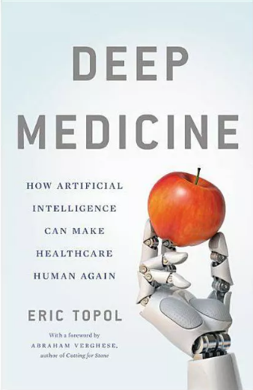

Motivation:
“A pinch of prevention is worth a pound of cure.”
People who have CVDs need early detection and management.
Notes:
This is a book that a friend recommended to me a few years ago. It’s about how machine learning is used in radiology to liberate radiologists from sitting in dark rooms looking at scans all day. They can have more patient contact,
Doctors need to have the time and the space to be doctors: attentive, hands-on, hands-free, not-rushed, informed.
How accurately I could predict a medical emergency Before it happened, saves time and money for both the patients and families, and the doctors.
It turns out that most CVDs can be prevented or minimized by addressing risk factors such as unhealthy diet, physical inactivity, and tobacco and alcohol use.
This is an excellent use for a machine learning model.

Slide 4
RESEARCH question
Can I predict heart failure morality from the data provided from diagnostic labs?
Notes:
Blood tests, Echocardiograms, physicals
While patient is getting a check up or starting to experience symptoms

Slide 5
Data Sources
Heart Failure Prediction | Kaggle
Davide Chicco, Giuseppe Jurman: Machine learning can predict survival of patients with heart failure from serum creatinine and ejection fraction alone. BMC Medical Informatics and Decision Making 20, 16 (2020). (link)
Notes:
David Chico and Dr. Jurman.
So, let’s explore if this true.

Slide 6
Exploratory data analysis: what are the features?
Anemia: Decrease of red blood cells or hemoglobin
Creatinine phosphokinase: Level of the CPK enzyme in the blood (mcg/L)
Diabetes: If the patient has diabetes
Ejection fraction: Ejection fraction (EF) is a measurement, expressed as a percentage, of how much blood the left ventricle pumps out with each contraction
High blood pressure: blood hypertension
Platelets: are a component of blood whose function (along with the coagulation factors)
Serum Creatinine: Serum creatinine is widely interpreted as a measure only of renal function
Serum Sodium: to see how much sodium is in your blood it is particularly important for nerve and muscle function.
Gender: Male or Female
Notes:
During my exploratory data analysis, 8 features (not including time or target)
Time is the follow up in days
TIME is directly indicative of survival which is why it was not a good feature.
And of course, DEATH_EVENT is the target.

Slide 7
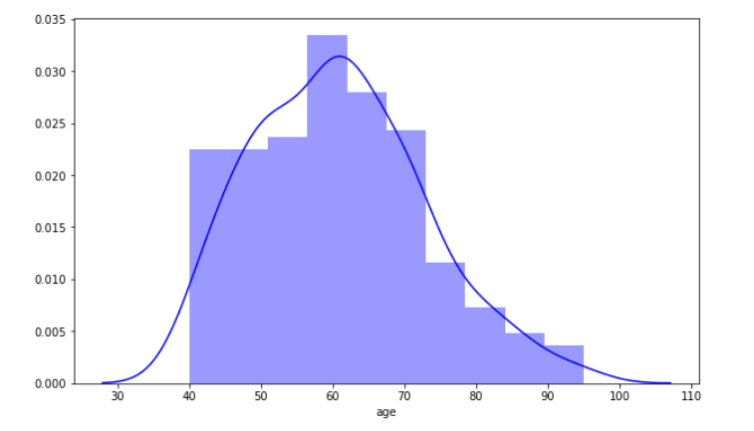
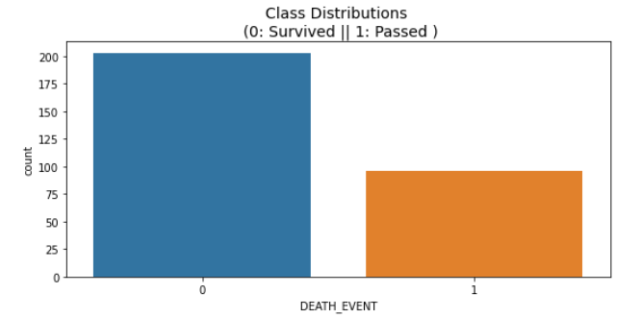
Exploratory data analysis: Who are the participants?
Number of participants who lived versus died
Visualizing the age distribution of study participants
Notes:
I had a preconceived notion that age and gender would play an important role in predicting heart failure. As it seems to do in other heal ailments.
Mean 63
299 participants. Unfortunately, 99 of those participants died in the time given for the study.
So from here I wanted to dive further into the features that could be used.
The dataset was actually pretty clean when I started. There were no null values, and I didn’t have to remove any data points, though I did realize that there may have been some outliers.

Slide 8
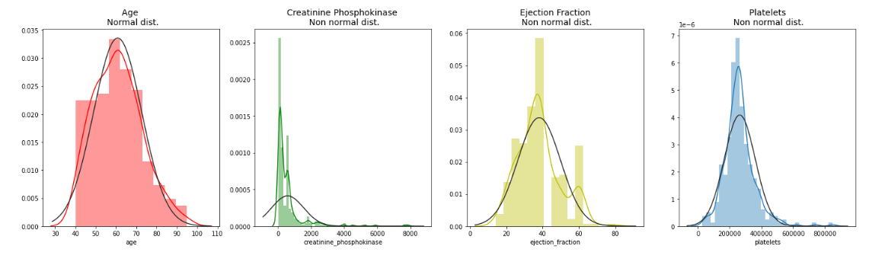
Exploratory data analysis: What features do I think will be important?
Preliminary visualizations of features
Notes:
I wanted to see the distribution of a subset of the features
I want to bring your attention specifically to ejection fraction which is bimodal. I was curious if any features data would be bimodal – making it clear which were likely to be the most important features, and also where the threshold might be for skewed values.
Platelets, for example, is a non-normal distribution, but that turned out to be less –important features for predicting heart failure. The same with creatinine.
So here I shifted my gaze to looking at the correlations only between DEATH_EVENT.

Slide 9
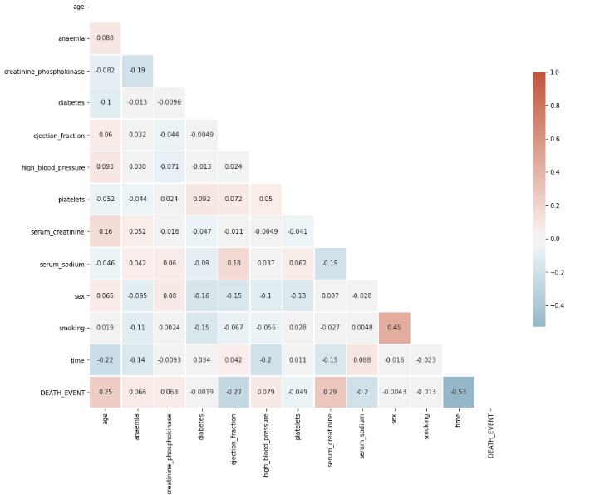
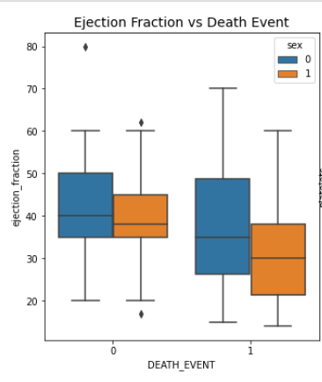
Exploratory data analysis: What features do I think will be important?
Female = 0
Male = 1
Notes:
So I knew that I wanted to predict heart failure (DEATH_EVENT)
Serum creatinine, ejection fraction, serum sodium
Time, as well, is very highly correlated with death event, but again is a direct correlation to living.
I also wanted to know if there could be any relationships between one of the predicted features and gender. It seems that men who passed away typically had a lower on average ejection fraction than women. This is the kind of data that could prove to be incredibly important in the hospital. – its important to find the average for both genders, as a woman may be in distress far earlier based on the average value of ejection fraction correlated with heart failure.

Slide 10
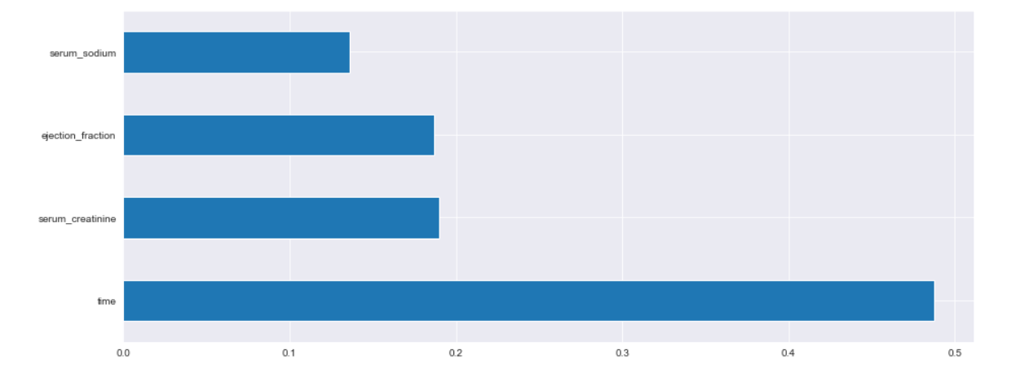
Modeling and Assumptions: Feature selection
ExtraTreesClassifier for feature importance
0.18692259, 0.18974064, 0.13596741, 0.48736937
Notes:
But I wanted to see if that was accurate for modeling.
I used an Extra Trees Classifer to predict the three most important variables for DEATH_EVENT.

Slide 11
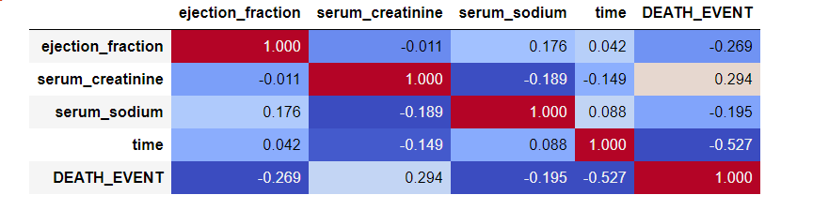
Modeling and Assumptions: Feature selection
Notes:
Negatively correlated
As ejection fraction and serum sodium decrease, heart failure is more likely
As Serum creatinine decreases, heart failure is less likely

Slide 12
Modeling and Assumptions
4 models
Logistic Regression
KNN (K Nearest Neighbors) Classifier
Decision Tree Classifier
Random Forest Classifier
Notes:
These are the 4 models I used for my predictions.
First, I used the logistic regression model to perform a baseline. I ran it without scaling the data or removing all but the 3 features from my feature selection.
Then, I ran the logistic regression again, as well as a KNN, Decision tree classifier, and a random forest classifier.

Slide 13
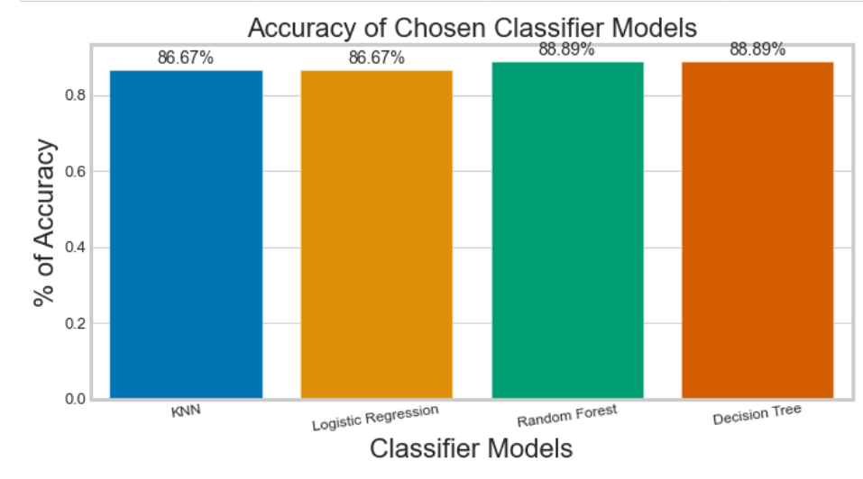
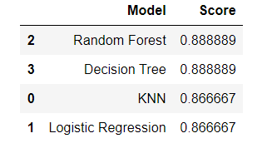
Results
Notes:
On this particular run, the random forest algorithm had the highest % accuracy at 89 %.
WITHOUT TIME.

Slide 14
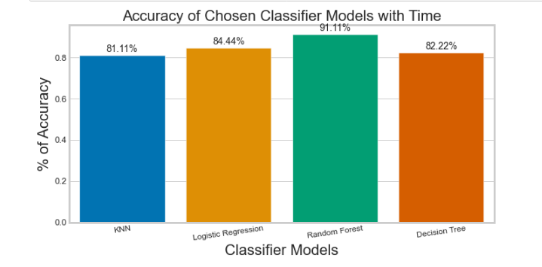
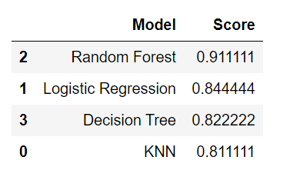
Results

Slide 15
Conclusions and limitations
Heart failure can be predicted by diagnostic tests.
Scientifically
GFR may be a more specific measure than creatinine (not as easy to obtain from patients)
BNP could be used rather than ejection_fraction and could possibly be a more powerful indicator of heart failure
Model
Wide ranges in results based on the training and testing sets
Notes:
And, I think it should be. Removing some the human error from hospitals can help to increase the efficiency and accuracy of diagnostics, as well as make healthcare human again. ALLOWING doctors to be attentive, hands-on, hands-free, not-rushed, informed.
Ejection fraction is a procedure (ultrasound)
BNP is a blood draw
So, to go a step further, it’d be important to get more data

Slide 16
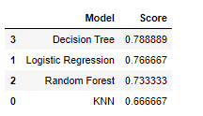
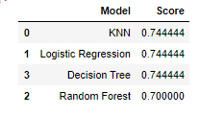
Conclusions and Limitations
Original
Run 3
Run 4

Slide 17
Next steps and Recommendations
Identify outliers and determine how to best model them without overfitting
Try more classification models including CatBoost and XGBoost
Create a baseline where patients within a certain “score” are put on a plant-based diet and workout regime.
Notes:
To deploy this in real life

Slide 18

Questions?

Slide 19
Confusion Matrix
Decision Tree Classifier
Logistic Regression
66
3
0 (Live)
TP
FP
64
5
0 (Live)
TP
FP
7
FN
TN
14
7
FN
1 (Die)
TN
14
1 (Die)
0 (Live)
1 (Die)
0 (Live)
1 (Die)
KNN Classifier
Random Tree Classifier
65
4
64
5
TP
FP
0 (Live)
TP
FP
0 (Live)
6
FN
7
FN
TN
15
TN
14
1 (Die)
1 (Die)
0 (Live)
1 (Die)
0 (Live)
1 (Die)

